Slide 1
ASP.NET MVC

Slide 2
ASP.NET Models
ASP.NET supports three different development models:
Web Pages:
Web Pages is the easiest development model for developing ASP.NET web sites.
MVC (Model View Controller):
MVC is a model for building web applications using a MVC (Model View Controller) design.
Web Forms:
Web Forms is the traditional ASP.NET model, based on event driven Web Forms and post backs.

Slide 3
Code-behind model
It encourages developers to build applications with separation of presentation and content in mind.
In theory, this would allow a web designer, for example, to focus on the design markup with less potential for disturbing the programming code that drives it.
This is similar to the separation of the controller from the view in Model–View–Controller (MVC) frameworks.
Using "code behind" separates the presentation logic from UI visualization.

Slide 4
ASP.NET Web Forms
Rich controls and tools
Postbacks
Event driven web development
Viewstate
Less control over the HTML
Hard to test
Rapid development

Slide 5
Program Structure
ASP.NET pages have the extension .aspx, and are normally written in VB (Visual Basic) or C# (C sharp).
Razor is a new and simple markup syntax for embedding server code into ASP.NET web pages.

Slide 6
Beforehand – ASP.NET Web Forms
What is MVC
What is ASP.NET MVC?
Models
Views
Controllers
Validation
Routing
Unit Tests
View engines

Slide 7
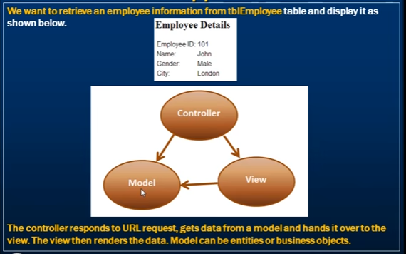

Slide 8
Model – View - Controller
Controller - responsible for handling all user input
Model - represents the logic of the application
View - the visual representation of the model

Slide 9
Models
The model should contain all of the application business logic, validation logic, and database access logic.
ASP.NET MVC is compatible with any data access technology (for example LINQ to SQL)
All .edmx files, .dbml files etc. are located in the Models folder.

Slide 10
Custom View Models
When you combine properties to display on a View
namespace ContosoUniversity.ViewModels
{
public class AssignedCourseData
{
public int CourseID { get; set; }
public string Title { get; set; }
public bool Assigned { get; set; }
}
}

Slide 11
What is Controller?
It is a class
Derives from the base System.Web.Mvc.Controller class
Generates the response to the browser request
public class HomeController : Controller
{
public ActionResult Index()
{
ViewBag.Message = "Welcome to ASP.NET MVC!";
return View();
}
public ActionResult About()
{
return View();
}
}

Slide 12
Controller Actions
Public method of the Controller class
Cannot be overloaded
Cannot be a static method
Returns action result
public ActionResult About()
{
return View();
}

Slide 13
Action Results
Controller action response to a browser request
Inherits from the base ActionResult class
Different results types

Slide 14
Action Results Types
ViewResult
EmptyResult
RedirectResult
JsonResult
JavaScriptResult
ContentResult
FileContentResult
FileStreamResult
FilePathResult

Slide 15
Action selectors
Action selectors are attributes that can be applied to action methods and are used to influence which action method gets invoked in response to a request. It helps the routing engine to select the correct action method to handle a particular request.
It plays a very crucial role when you are writing your action methods. These selectors will decide the behavior of the method invocation based on the modified name given in front of the action method. It is usually used to alias the name of the action method.

Slide 16
Three types of action selector attributes
ActionName
This class represents an attribute that is used for the name of an action. It also allows developers to use a different action name than the method name
public class HomeController : Controller
{
// GET: Home public string Index()
{
return "This is ASP.Net MVC Filters Tutorial";
}
[
ActionName("CurrentTime")]
public string GetCurrentTime()
{
return DateTime.Now.ToString("T");
} }

Slide 17
NonAction
NonAction is another built-in attribute, which indicates that a public method of a Controller is not an action method. It is used when you want that a method shouldn’t be treated as an action method.
ActionVerbs
Another selector filter that you can apply is the ActionVerbs attributes. So this restricts the indication of a specific action to specific HttpVerbs. You can define two different action methods with the same name but one action method responds to an HTTP Get request and another action method responds to an HTTP Post request.

Slide 18
MVC framework supports the following ActionVerbs.
HttpGet
HttpPost
HttpPut
HttpDelete
HttpOptions
HttpPatch

Slide 19
Controller base class methods
View
Redirect
RedirectToAction
RedirectToRoute
Json
JavaScriptResult
Content
File

Slide 20
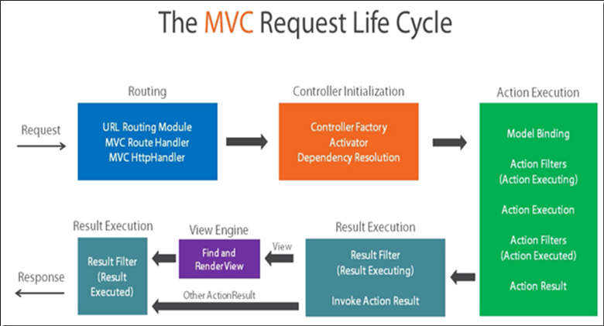

Slide 21
Pass Data to a View
With ViewData:
ViewData["message"] = "Hello World!";
Strongly typed ViewData:
ViewData.Model = OurModel;
With ViewBag:
ViewBag.Message = "Hello World!";

Slide 22
HTML Helpers
Methods which typically return string.
Used to generate standard HTML elements
textboxes, dropdown lists, links etc.
Example: Html.TextBox() method
Usage is optional
You can create your own HTML Helpers

Slide 23
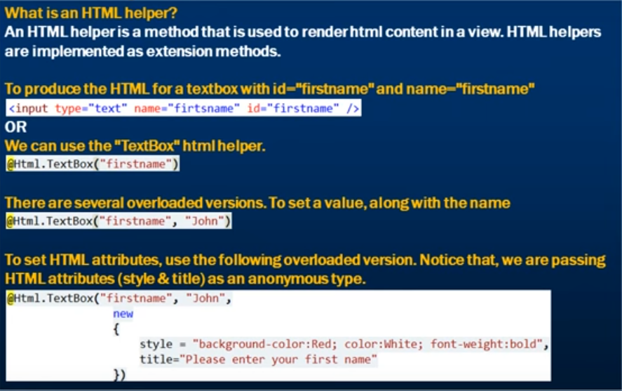
Forms and Helper

Slide 24
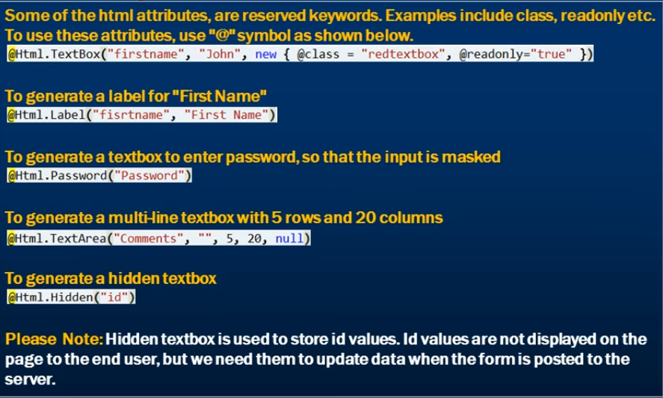

Slide 25
Routing
The Routing module is responsible for mapping incoming browser requests to particular MVC controller actions.
Two places to setup:
Web.config file
Global.asax file

Slide 26
Routing Setup
<system.web>
<httpModules>
…
<system.webServer> <modules> …
<system.web>
<httpHandlers> …
<system.webServer> <handlers> …

Slide 27
Routing Setup
Global.asax file
public class MvcApplication : System.Web.HttpApplication
{
public static void RegisterRoutes(RouteCollection routes)
{
routes.IgnoreRoute("{resource}.axd/{*pathInfo}");
routes.MapRoute(
"Default",
"{controller}/{action}/{id}",
new { controller = "Home",
action = "Index", id = "" }
);
}
protected void Application_Start()
{
RegisterRoutes(RouteTable.Routes);
}
}

Slide 28
View Engines
Handles the rendering of the view to UI (html/xml);
Different view engines have different syntax
ASP.NET MVC 3 Pre-included View Engines:
Web Forms
Razor

Slide 29
Razor Syntax Rules
Razor using an @ character instead of aspx's <% %> and Razor does not require you to explicitly close the code-block, this view engine is parsed intelligently by the run-time to determine what is a presentation element and what is a code element. Razor view engine is compatible with unit testing frameworks. This is the default view engine in MVC 3 and MVC 4. Web pages with Razor syntax have the special file extension cshtml (Razor with C#) or vbhtml (Razor with VB).

Slide 30
Comment in ASPX and Razor View Engine
@*Your Razor Comment Here*@
<%--Your Razor Comment Here--%>
In a C# code block the comment for Razor or ASPX will be // and /* */ comment delimiters. Following code shows comments inside a c# code block.
@{
//Razor
//Single line comment
/* Multi line comment */
}
<%
//ASPX
//Single line comment
/* Multi line comment */
%>

Slide 31
Razor View Engine
@{
string strVariable = "Razor Stirng";
bool isRazor = true;
string[] arrRazor = new string[] { "MVC", "RAZOR", "AXPS"};
}
<span>@Your Code</span>
@if (isRazor)
{
<span>ViewEngine:Razor</span>
}
else
{
<span>ViewEngine:Other</span>
}

Slide 32
<ul>
@foreach (var item in ListItem)
{
<li>@item</li>
}
</ul>

Slide 33
Delegate in Method in ASPX and Razor View Engine
@{
Func<string[], object=""> SomeList =
@<ul>
@foreach (string p in item)
{
<li>@p</li>
}
</ul>;
}
Some listing from delegate-
@SomeList(ListItem);
</string[],>

Slide 34
Filters
In ASP.NET MVC, controllers define action methods that usually have a one-to-one relationship with possible user interactions, but sometimes you want to perform logic either before an action method is called or after an action method runs.
To support this, ASP.NET MVC provides filters. Filters are custom classes that provide both a declarative and programmatic means to add pre-action and post-action behavior to controller action methods.

Slide 35
Types of Filters
Authorization Filters − Implements the IAuthorizationFilter attribute.
Action Filters − Implements the IActionFilter attribute.
Result Filters − Implements the IResultFilter attribute.
Exception Filters − Implements the IExceptionFilter attribute
Filters are executed in the order listed above. For example, authorization filters are always executed before action filters and exception filters are always executed after every other type of filter.

Slide 36
References.
https://www.tutorialspoint.com/asp.net_mvc/index.htm
https://www.codeproject.com/Articles/866143/Learn-MVC-step-by-step-in-days-Day

